Slide 1
Handwritten Digit Generation using GANs
A presentation on the intricate workings of GANs in generating realistic handwritten digits and their potential in various applications.
-Yathindra Pravanan TV
-311521104063

Slide 2
Table of Contents
Introduction
How does it work
Understanding GAN
Challenges and limitations
Applications and Future Scope
Conclusion

Slide 3
Introduction
Importance and relevance of handwritten digit generation
Overview of machine learning and artificial intelligence
Captivating visuals

Slide 4
Introduction
In recent years, the field of machine learning has witnessed remarkable advancements, particularly in the realm of generative models. GANs, in particular, have emerged as a groundbreaking technique for generating realistic data samples, including handwritten digits. In this presentation, we delve into the fascinating world of GANs and explore how they can be leveraged to create handwritten digits with astonishing accuracy and realism.

Slide 5
How does it work?
Challenges encountered
Exploration of the training process of GANs
Adversarial training paradigm
Tips and tricks for optimizing GAN training
Visually appealing graphics

Slide 6

Understanding GAN
Foundational concepts of GANs
How GANs generate realistic handwritten digits
Generative models via adversarial training.
Two networks: generator, discriminator.
Goal: generator mimics real data.
Adversarial process refines generator.
Diverse applications in image synthesis.

Slide 7
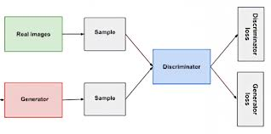
Understanding GAN
Understanding Generative Adversarial Networks (GANs) is crucial in grasping the dynamics behind generating realistic data. Introduced by Ian Goodfellow and his team in 2014, GANs have revolutionized generative modeling, attracting widespread attention for their ability to create highly convincing data samples. At its core, a GAN consists of two neural networks: the generator and the discriminator. The generator's role is to produce synthetic data samples, while the discriminator aims to distinguish between real and fake data. Through an adversarial training process, these networks engage in a game-like scenario where the generator strives to generate data indistinguishable from genuine samples, while the discriminator seeks to accurately differentiate between real and fake data. This interplay leads to the refinement of both networks over time, ultimately resulting in the generation of high-quality synthetic data. The architecture of GANs typically comprises two networks: the generator and the discriminator. During training, the generator receives random noise vectors as input and produces synthetic data samples, while the discriminator learns to distinguish between real and fake samples.

Slide 8
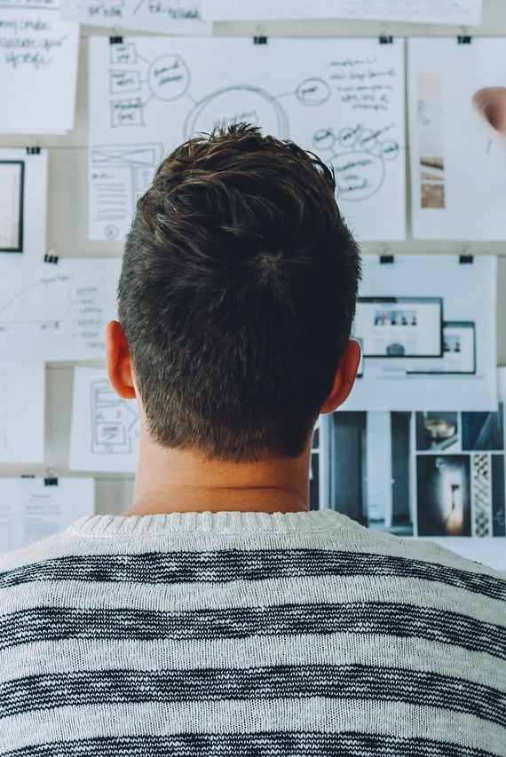
Challenges and Limitations
Future directions for research and development
Future GAN research focuses on stability, mode collapse, novel architectures, ethical concerns, interdisciplinary collaboration, and expanding applications across domains.
Mode collapse and overfitting in GANs
Mode collapse in GANs: limited diversity in generated samples. Overfitting: generator fails to capture full data distribution, reducing model efficacy.
Strategies for mitigating challenges
Strategies for mitigating challenges in GANs include architectural modifications, regularization techniques, diverse training data, and novel loss functions.

Slide 9
Applications and Future Scope
Real-world applications of GAN-generated handwritten digits
Generating synthetic data for training robust ML models
Enhancing dataset diversity
Compelling examples and visuals

Slide 10
Applications and Future Scope
Applications and Future Scope of Generative Adversarial Networks (GANs) span a wide array of fields, promising transformative impacts on various industries and research domains. GANs have already demonstrated their versatility and potential in numerous applications, and their future scope continues to expand as researchers explore novel use cases and address existing challenges.
In the realm of computer vision, GANs have revolutionized image generation, enabling the creation of photorealistic images from textual descriptions or sketches. This capability has profound implications for industries such as advertising, entertainment, and fashion, where high-quality visual content is paramount. GANs are also employed in image-to-image translation tasks, facilitating tasks like style transfer, image super-resolution, and domain adaptation.
Looking ahead, the future scope of GANs holds tremendous potential for further innovation and advancement. Research efforts are focused on addressing challenges such as training stability, mode collapse, and ethical considerations surrounding the generation of synthetic data. Novel architectures, training techniques, and applications of GANs are continuously being explored, paving the way for advancements in areas such as:
3D object generation and manipulation
Audio synthesis and music composition
Robotics and autonomous systems
Personalized content generation
Environmental simulation and climate modeling.

Slide 11
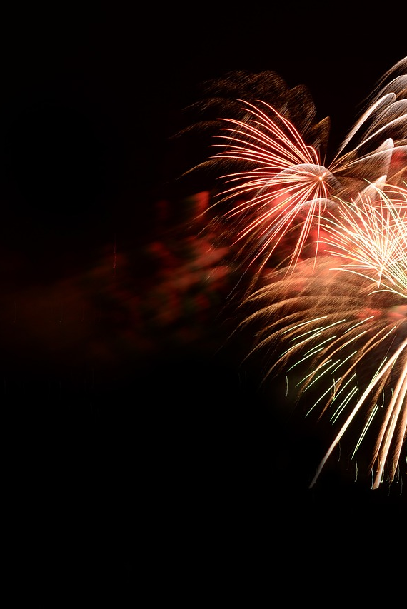
Conclusion
In conclusion, Generative Adversarial Networks (GANs) represent a groundbreaking advancement in the field of artificial intelligence, offering unparalleled capabilities in generating realistic data across various domains. From computer vision to natural language processing and beyond, GANs have demonstrated their versatility and potential in a myriad of applications, revolutionizing industries and driving innovation. Through an adversarial training paradigm, GANs enable the creation of lifelike images, texts, and other data types, with implications ranging from entertainment and healthcare to education and beyond.
In essence, Generative Adversarial Networks represent not just a technological advancement, but a paradigm shift in how we interact with and utilize artificial intelligence. With continued research, collaboration, and exploration, the potential of GANs is limitless, offering boundless opportunities for discovery, creativity, and progress. As we embark on this journey, let us embrace the power of GANs to imagine, create, and innovate, shaping a future where artificial intelligence enriches and enhances every aspect of our lives.

Slide 12
Thank you. 😄

